Slide 1
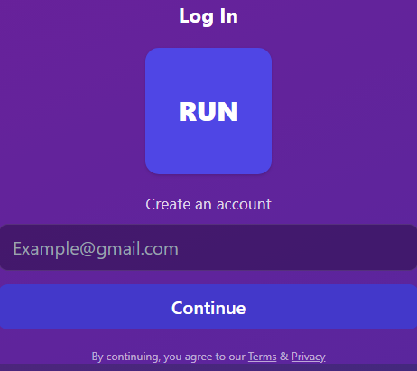
Team Run Group Members- 1. Daniel Herrera 2. Carlos Martinez 3. Anthony Jimenez 4. Harut Kulakchian 5. Osbaldo Bravo
Tool Name- Workout RPG Tracker Team Name- RUN
API Name- HealthKit / Google Fit (Primary) Alternate APIs (For Future Use): Fitbit API, Garmin API

Slide 2
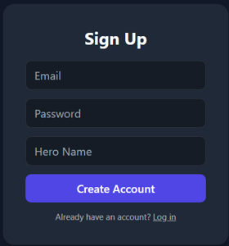
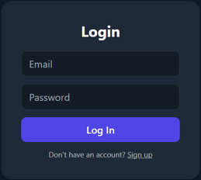
Project Summary
Workout RPG Tracker is a fitness tracking web/mobile application that combines workout logging with role-playing game mechanics. Users log exercises such as pushups, squats, pull-ups, and hydration intake. Each activity updates character stats in real time.
The application connects to wearable APIs (HealthKit / Google Fit) to retrieve heart rate and activity data. Logged workouts increase character attributes like strength, stamina, and agility.
The system stores user data securely, calculates experience points (XP), and unlocks features such as boss battles, raids, customization, and progression zones based on consistency and performance.
The goal is to increase workout motivation through a game while maintaining real fitness tracking accuracy.

Slide 3
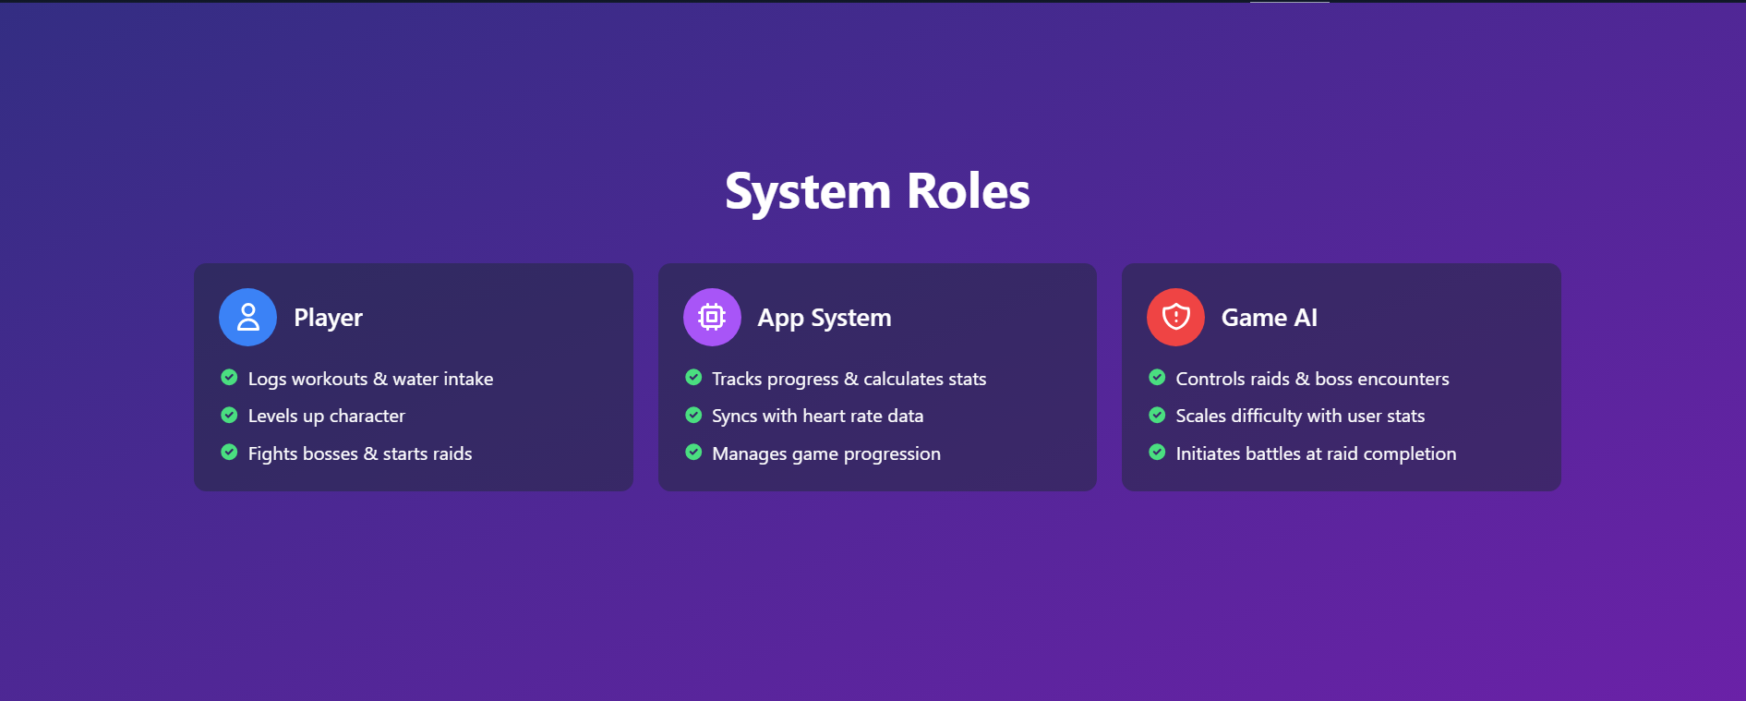
System Roles
Game Engine / AI System
User (Player)
Application System
Creates account and logs in
Logs workouts and hydration
Connects smartwatch or fitness API
Customizes character
Participates in raids and boss battles
Authenticates users
Stores and retrieves workout data from database
Calculates XP and character stat increases
Syncs wearable data from APIs
Controls progression logic
Determines raid difficulty
Calculates boss battle outcomes
Applies stat multipliers
Triggers reward system

Slide 4
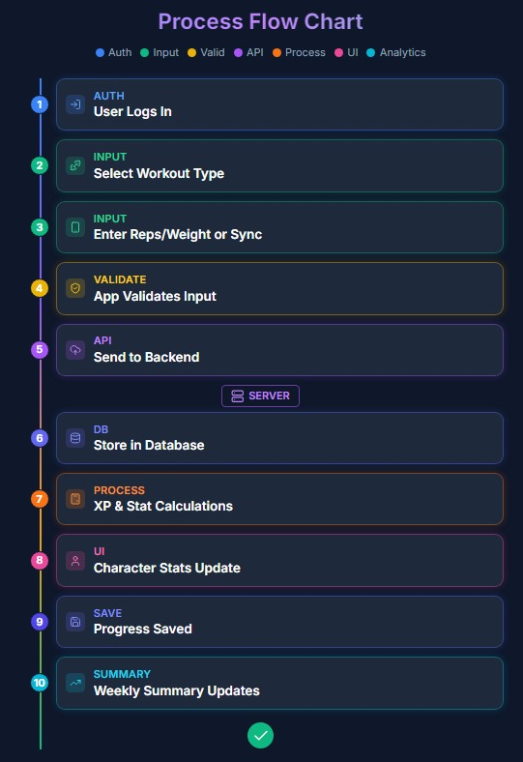


Process Flow Chart

Slide 5
Accessibility Design
Large readable fonts
High contrast color mode
Dark mode option
Screen reader support
Simple navigation layout
Clear button labels
Alternative text for animations
Adjustable notification settings

Slide 6

Development & Deployment
Development:
Localhost testing
GitHub version control
Docker for containerization
Deployment:
Hosted on AWS or Render
MySQL cloud database
HTTPS encryption enabled

Slide 7
Passwords encrypted using BCrypt
JWT authentication
Input validation to prevent SQL Injection
CSRF protection enabled
HTTPS required
Role-based authorization
Rate limiting on API endpoints
Security Design

Slide 8
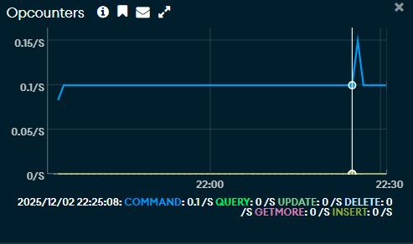
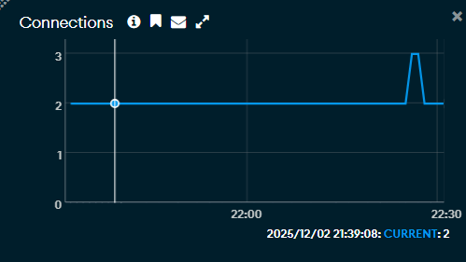
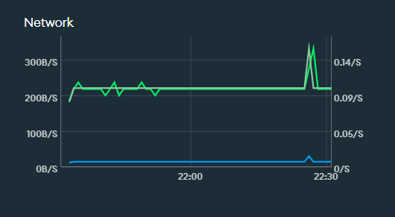
Metrics & Achievements
Performance Comparison
During testing, we noticed faster loading times and smoother updates around night compared to mornings.
Response Time Improvement
We monitored our deployed backend and saw consistent response activity with no crashes while sending multiple requests.
Feature Implementation Rate
We have the main features:
Account creation and login
Secure user authentication
Workout and water logging that saves to the database
We focused on getting the core functionality done before moving on to extra features.

Slide 9
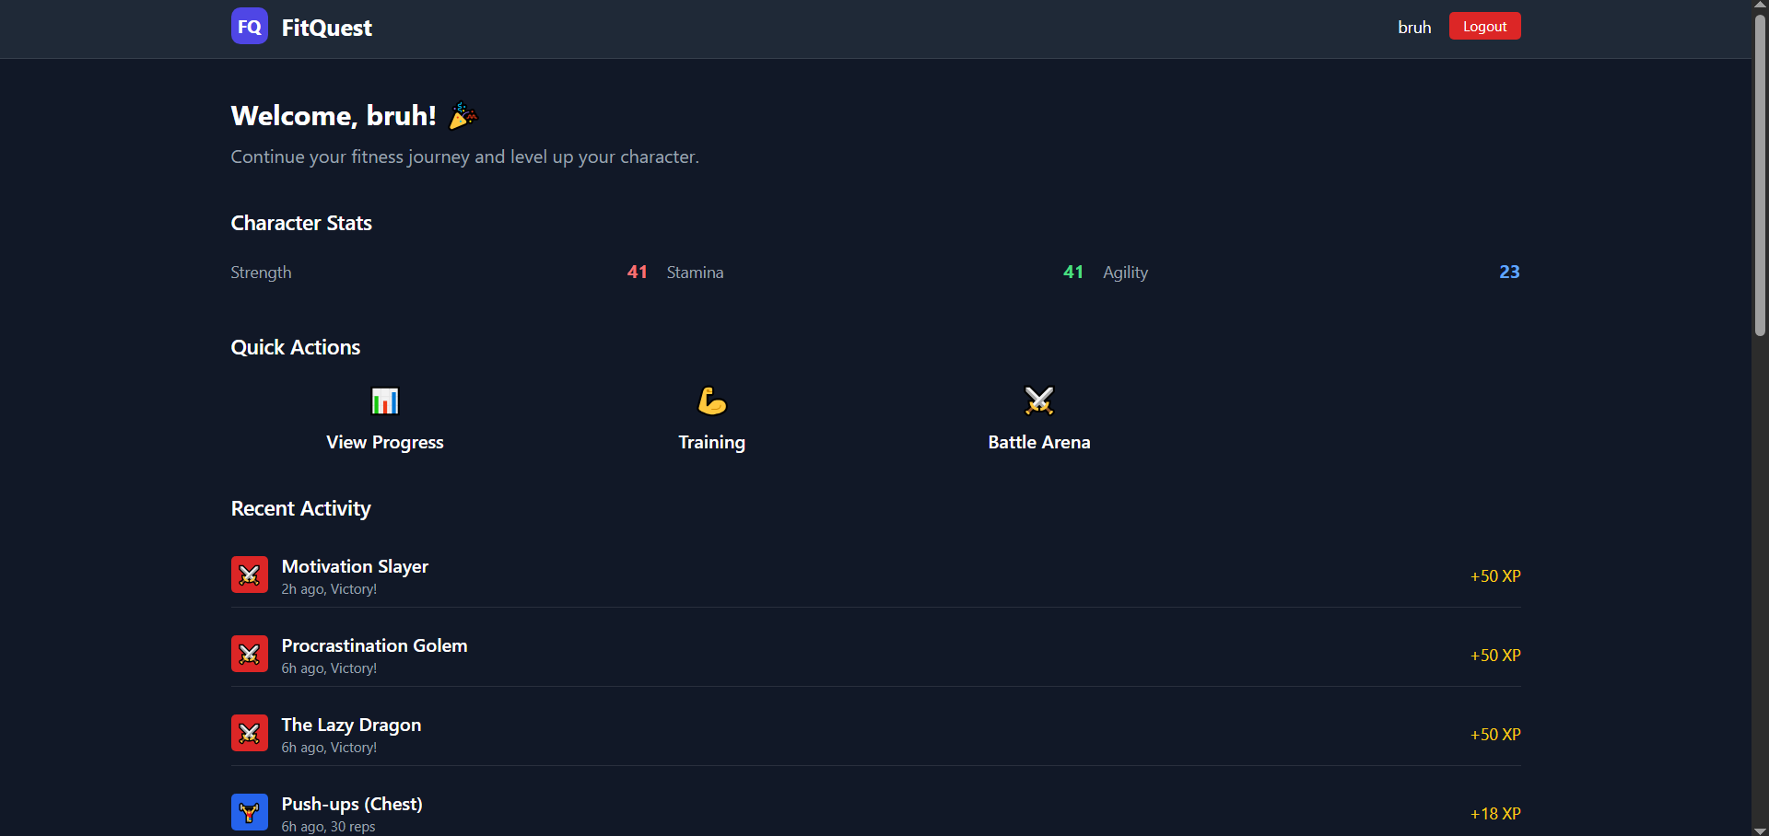
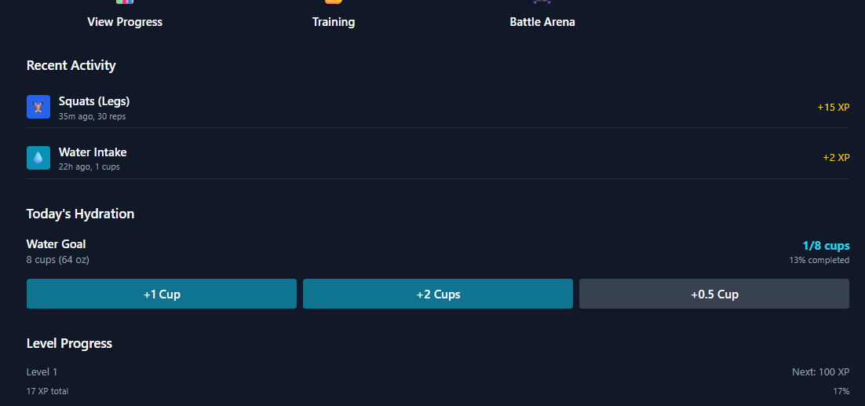
View of The App

Slide 10

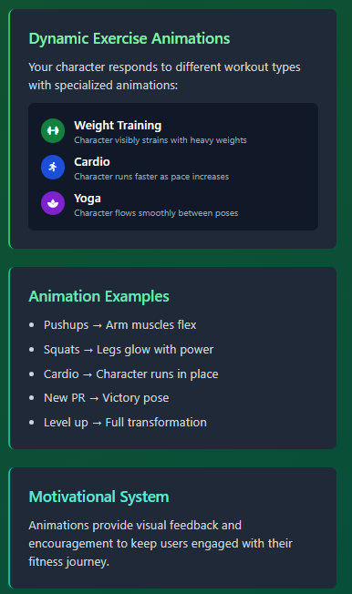
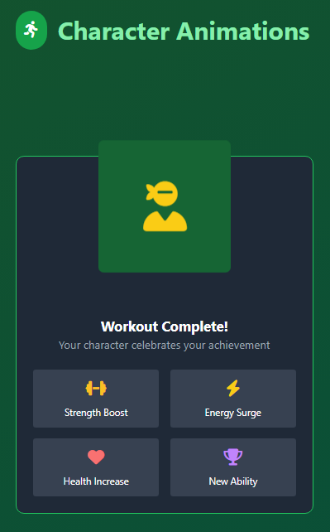

Slide 11

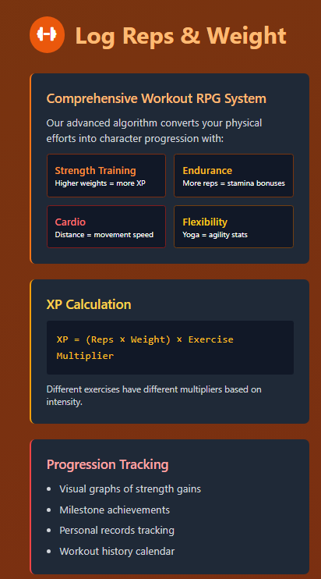
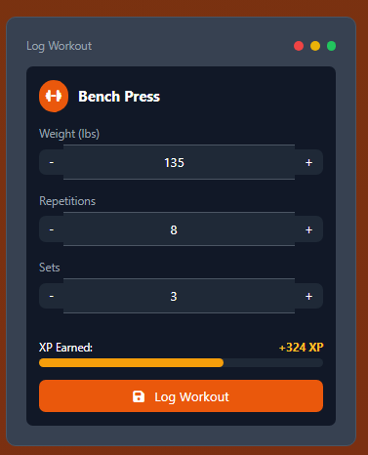

Slide 12
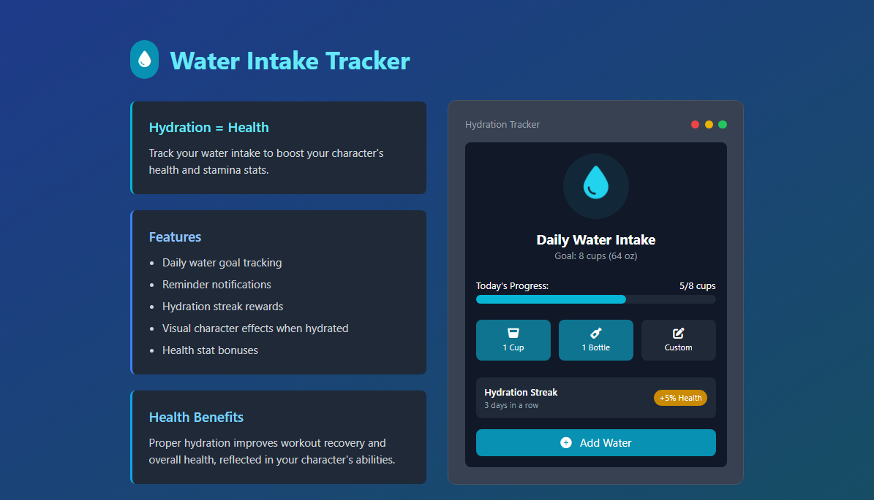

Slide 13
User Stories: (examples)
1. As someone who plays games and goes to the gym, I want a tracker that keeps me incentivized so that I stay consistently in the gym.
Acceptance Criteria:
a. User can tie progress to an account.
b. User can let built-in software have certain permissions.
c. User can create a character.
Tasks:
a. Create an account using email/password
b. Enable tracking permissions such as heart rate, steps, breathing, and water intake
c. Create and design a character in a design area UI
2. As someone who struggles with warming up, I want a plan that will have warm-ups that
will keep me engaged.
Acceptance Criteria:
a. User can choose a “Warm-Up” option
b. User can choose between set warm-ups or create their own
c. User can choose to display a timer or a video for the warm-ups chosen
d. User can see a character animation do it alongside him
Tasks:
a. Make a button that will lead to a set of warm-up options such as a light warm-up, or
heavy warm-up.
b. Will log the warm up and update stats accordingly
c. Displays the created character and animates the character doing the warm-ups

Slide 14
User Stories (Continued):
3. As someone who forgets to track my current workout, I want to be able to log my workout in a way that keeps me consistent and honest.
Acceptance Criteria:
a. User can choose what body part
b. User can enter the number of repetitions and weight
c. User can see character stats increase as information is logged
d. User can see character do animations based on the workout
Tasks:
a. Have body parts listed that the user can choose from
b. Show workouts related to the body part that the user can choose from
c. Be able to enter a custom amount of repetitions and weights for the workout chosen
d. Play an animation of the character doing the workout chosen
e. Increase the body part stats for the created character based on the info that the user inputs
4. As someone who struggles drinking enough water, I want to be able “game-ify” the task
so that I am no longer struggling with it
Acceptance Criteria:
a. User can choose a water intake option
b. User is able to choose the amount of water
c. User is able to see a water-intake progress bar
d. User can see the effect it has on character in raids/battles
Tasks:
a. Have a water icon displayed on screen that can be pressed
b. Show amounts of water (cups/bottles/ounces/etc.) that can be pressed and be able to
input an amount
c. Play an animation showing the progress bar filling up
d. Have and show battle buffs from the amount of water drank

Slide 15
User Stories (Continued):
5. As someone who can struggle with going to the gym, I want to see how not going can affect my character so that I have incentive to go consistently
Acceptance Criteria:
a. User can see stats lower
b. User can see chance of raid success lower
Tasks:
a. Have a custom schedule and track if user did not go and lower stats accordingly
b. Show a raid success percentage and have it lower according to how many days/what type of day is missed
6. As someone who likes seeing consistency rewarded, I want a way to visualize my own
diligence so that I would want to keep going
Acceptance Criteria:
a. User can see a 3/7/15/30 day consistency pop up
b. User can see a new map zone unlocked per each goal met
c. User can visually see the map unlock through an animation
Tasks:
a. Create a pop up that displays on each goal achieved
b. Have zones blocked until each day- streak is met
c. Display an animation for each zone unlocking that plays after achieving each goal

Slide 16
User Stories (Continued):
7. As someone who enjoys progressing to beat a boss, I want a way to see my progress reach a goal so that I can challenge a boss
Acceptance Criteria:
a. User can fight a boss at the end of a raid
b. User will be able to see if boss can be challenged based on stats
c. User can choose a reward after each boss beaten
d. User can choose to see or skip the battle animation and outcome
Tasks:
a. Have a boss as a battle at the end of a raid
b. The boss should be able to be challenged if the character reached the required stats
c. Cap the character reward to not be too powerful
d. Create a reward list to choose between after defeating the boss
e. Show a battle animation and outcome but let the user have the choice to skip it
8. As someone who enjoys earning rewards through effort, I want to unlock and equip gear
so that I can feel my progress making my character stronger
Acceptance Criteria:
a. User can unlock gear by meeting specific goals or milestones
b. User can equip or change gear once unlocked
c. User can view achievements related to unlocking gear
d. Equipping gear should increase character stats
Tasks:
a. Track milestone achievements and display them in a side slide notification
b. Lock gear until the required stats or goals are met
c. Create a wardrobe where new items appear once unlocked
d. Implement stat boosts when gear is equipped

Slide 17
User Stories (Continued):
9. As someone who wants an easier way to track workouts, I want to use my heart rate sensor so that my workouts log automatically without extra effort
Acceptance Criteria:
a. User can connect a smartwatch or other bluetooth heart rate device.
b. App can read and retrieve heart rate data during workouts
c. Heart rate data is automatically logged
d. System prevents fake workout entries
Tasks:
a. Implement Bluetooth connection to heart rate sensors
b. Retrieve and process heart rate data in real- time during workouts
c. Auto log heart rate as workouts progress
d. Disable manual logging when auto logging is active to prevent fake entries
10. As someone who wants to track my leg workouts, I want to log squats so that I can see
my character get stronger and recover energy faster
Acceptance Criteria:
a. User can select “legs” and then “squats” to log the workout
b. Logging squats increases the leg strength stat
c. Character plays a squat animation when the workout is logged
d. Leg strength stat visually updates on the character (strength/armor appearance)
Tasks:
a. Create a menu to log squats under the “legs” workout category
b. Update leg strength stat and energy recovery rate when squats are logged
c. Animate the character performing squats upon logging
d. Add visual indicators (strength or armor) to reflect increased leg stats

Slide 18
User Stories (Continued):
11. As someone who forgets to stay hydrated, I want water reminders during my workout so that I can maintain my performance and health
Acceptance Criteria:
a. User can enable or disable water reminders
b. User can set custom interval timers for reminders
c. Notifications alert the user to drink water during sessions
d. User can mute reminders or pause them with a “Break” option
e. User can confirm water intake or skip the reminder
Tasks:
a. Add a toggle to enable/disable water reminders
b. Implement customizable interval timers for alerts
c. Send notifications with customizable text during workouts
d. Create a “break” button to pause notifications until the user returns
e. Provide options to confirm “intake” or “skip” for each alert
12. As someone who likes personalizing my character, I want to unlock customization
options so that I can change my character’s appearance as I progress
Acceptance Criteria:
a. User unlocks character customization at level 10
b. User can apply new outfits or looks once unlocked
c. New styles unlock at specific milestones
d. Custom appearances can be saved to the profile
e. Some items remain locked until earned
f. Character model updates immediately when customization is applied
Tasks:
a. Enable outfit customization when the user reaches level 10
b. Create a menu to apply and change character appearances
c. Unlock additional styles at milestone levels
d. Save and load custom appearances for the character profile
e. Lock certain gear or styles until requirements are met
f. Update the character model dynamically when changes are applied

Slide 19
User Stories (Continued):
13. As someone who wants to improve my back strength, I want to log pull-ups so that I can see my character grow stronger with each workout
Acceptance Criteria:
a. User can select “back” and then “pull ups” to log the workout
b. Logging pull ups increases the back strength stat
c. Character performs a pull up animation when the workout is logged
d. Back strength stat updates visually on the character
Tasks:
a. Add a menu option under “back” workouts to log pull-ups
b. Update the back strength stat when pull ups are recorded
c. Play the correct pull up animation on the character upon logging
d. Ensure the character model reflects increased back strength after workouts
14. As someone who likes to track my progress, I want to see a weekly activity summary so
that I can review my workouts, hydration, and boss fights in one place
Acceptance Criteria:
a. User can tap “my week” to view a weekly summary
b. Weekly logs display all workouts, water intake, and boss fights
c. Stats are color coded by day for easy tracking
d. Each day shows accurate and detailed data
e. Daily entries are interactive for more information
Tasks:
a. Create a “my week” section to display weekly activity
b. Generate and update weekly logs automatically
c. Apply color coding to differentiate stats for each day
d. Ensure daily entries display precise workout, water, and boss fight data
e. Make daily entries interactive, allowing users to tap for more details

Slide 20
User Stories (end):
15. As someone who might miss workouts, I want a rest mode to appear after missing several
days so that I can visually see my character resting and feel motivated to return
Acceptance Criteria:
a. Rest mode activates and is visually shown if the user skips 3 or more consecutive
days
b. An XP progress bar pauses while rest mode is active
c. App sends a “Come back!” notification to encourage returning
d. Streak resets after 3 missed days, but rest mode remains visible until activity resumes
e. Character displays a clear resting animation or scene during rest mode
f. Rest mode screen provides an option to resume workouts and restart the streak
Tasks:
a. Implement a rest mode screen that appears when the streak is broken
b. Pause XP progression and display a visual indicator (dimmed screen, sleeping
character, etc.)
c. Send motivational “Come back!” notifications at set intervals
d. Reset the streak counter after 3 missed days while keeping rest mode active
e. Animate the character in resting state until the user logs a new workout
f. Add a “resume workout” or similar button to exit rest mode and restart progress

Slide 21

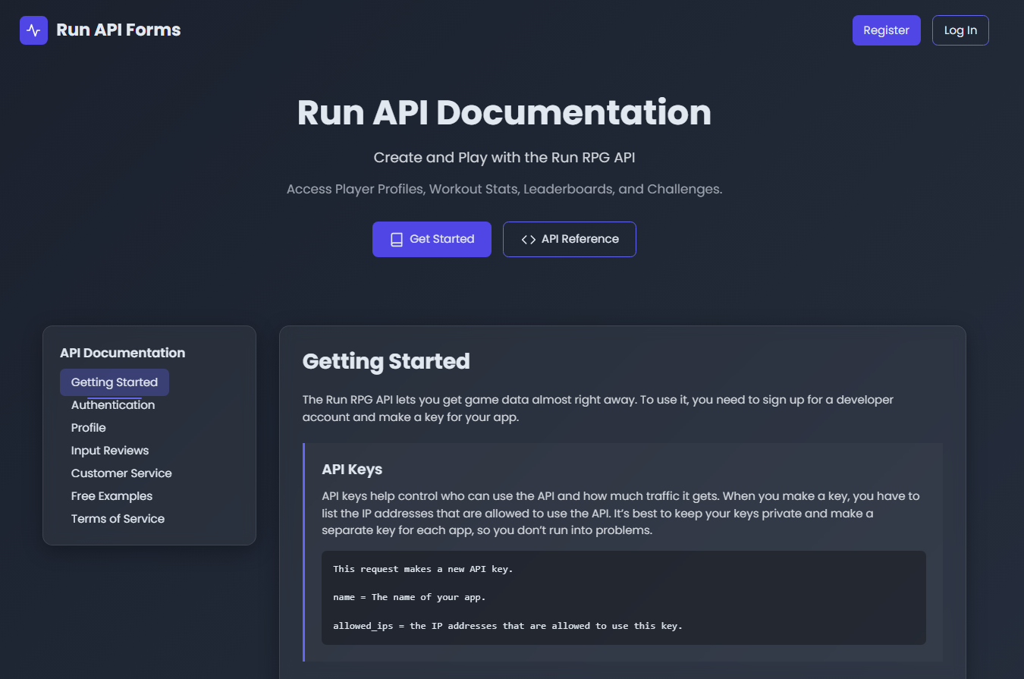

Slide 22

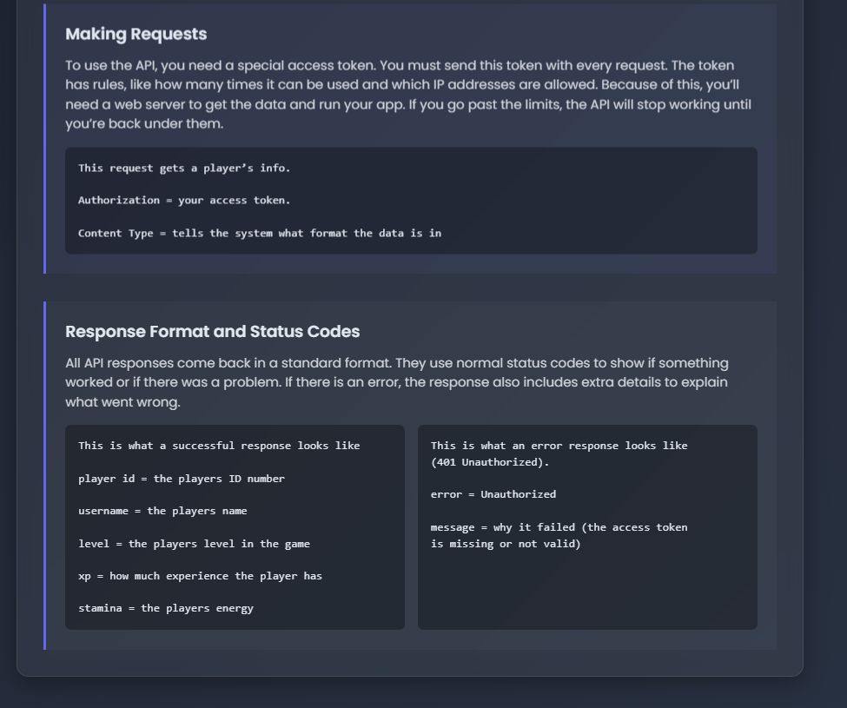

Slide 23

